Slide 1
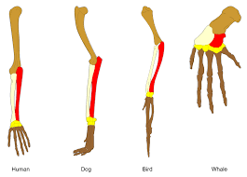
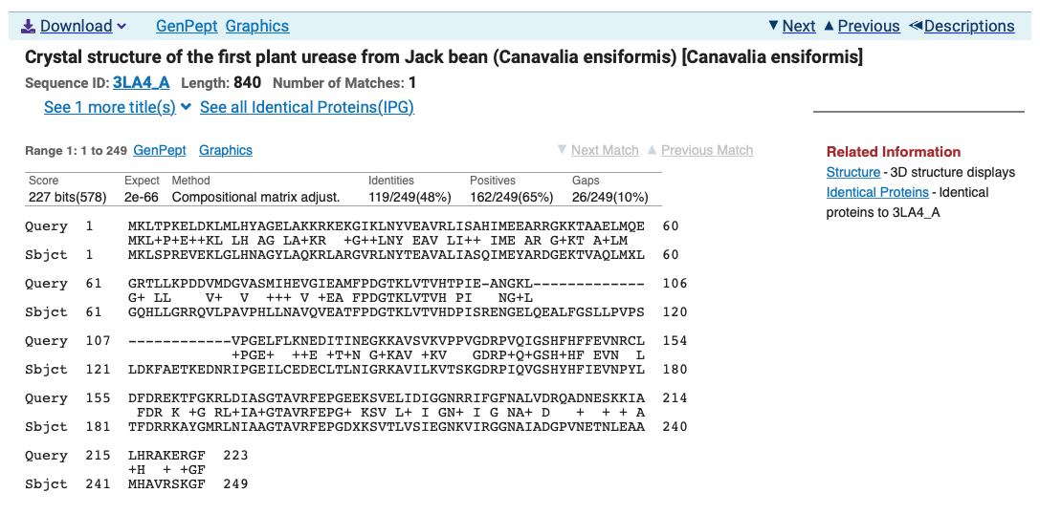
Sequence Homology A Rough Guide
Mark Pallen

Slide 2
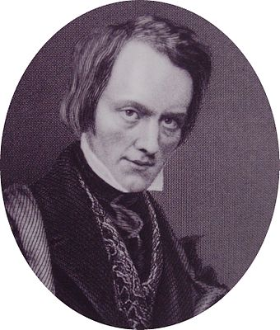
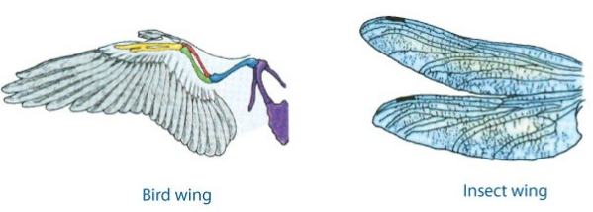
Defining homology
Term "homology" first used in biology by anatomist Richard Owen in 1843 studying vertebrate fins and limbs, defining it as "same organ in different animals under every variety of form and function”
contrasting with "analogy” to describe different structures with same function.
Owen’s criteria for determining homology:
position, development, composition.
homologous organs not necessarily similar (at least similarity may not be obvious)
similar organs are not necessarily homologous

Slide 3
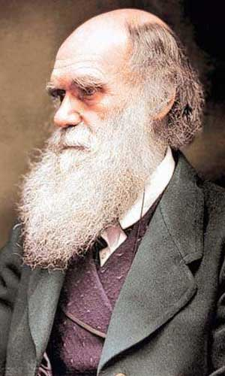
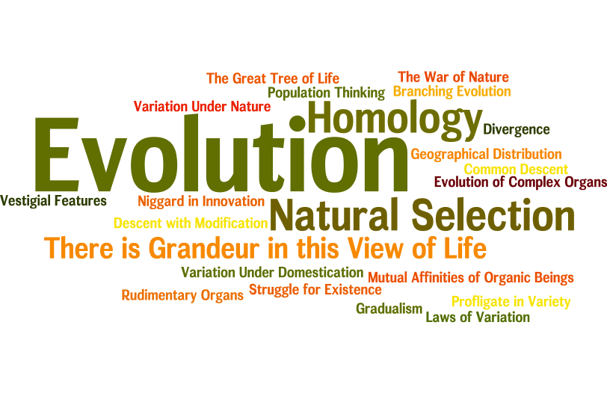
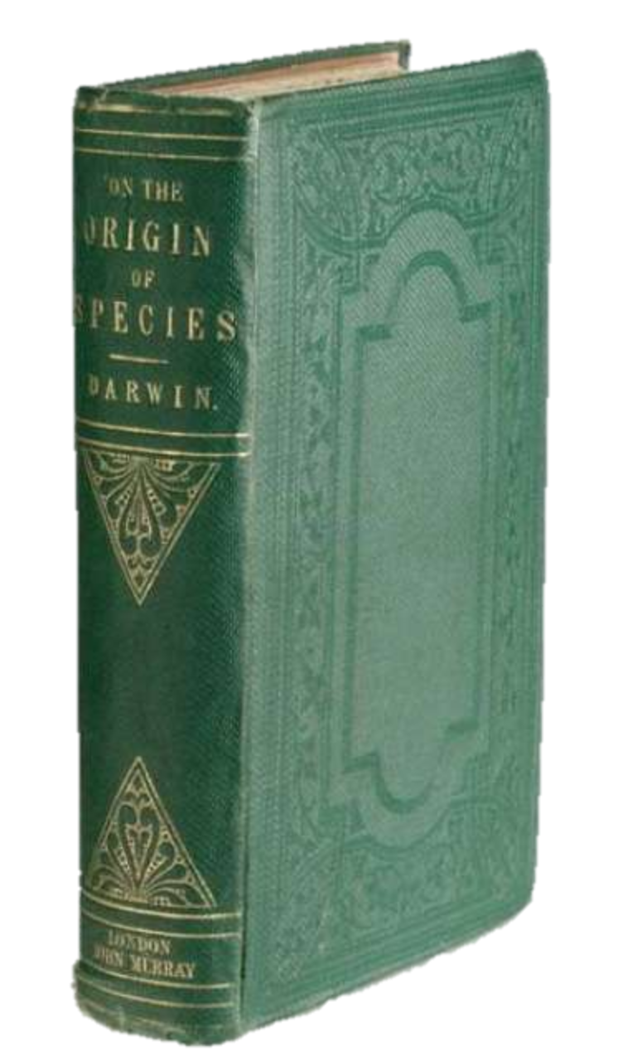
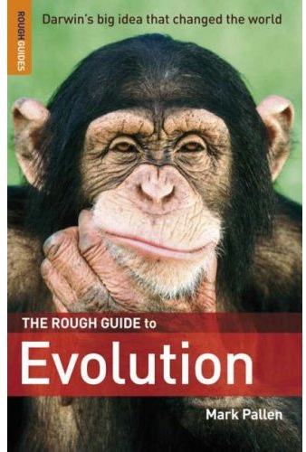
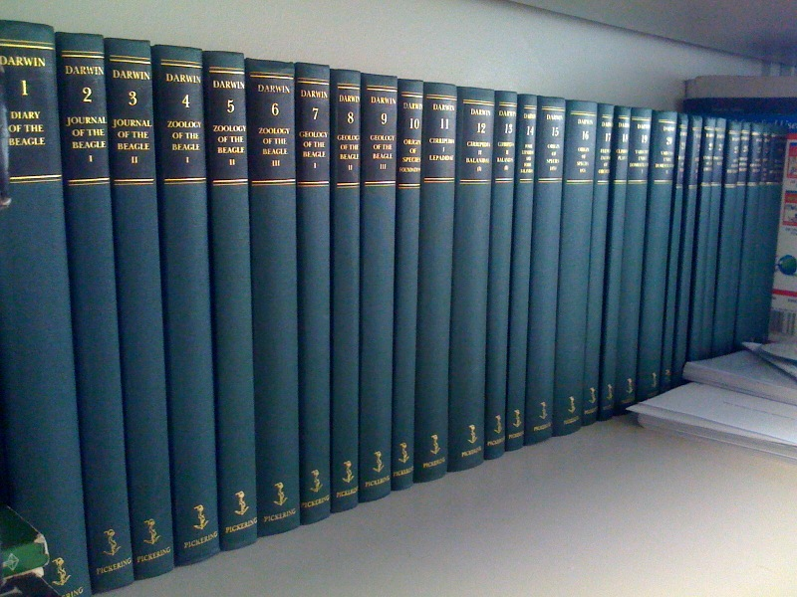

Slide 4
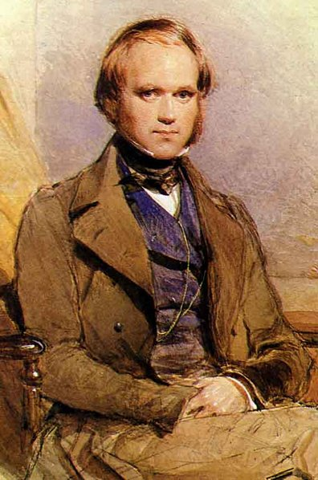
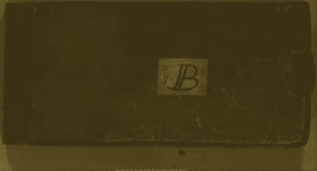
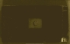
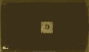
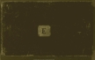
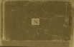
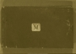
The Evolution of ideas Darwin’s Notebooks
If we choose to let conjecture run wild, then animals our fellow brethren in pain, disease, death and suffering, and famine, our slaves in the most laborious works, our companions in our amusements; they may partake from our origin in one common ancestor; we may be all netted together
https://www.youtube.com/watch?v=WnnJ3UxjYdc
https://www.youtube.com/watch?v=4yHHoCivCT0

Slide 5
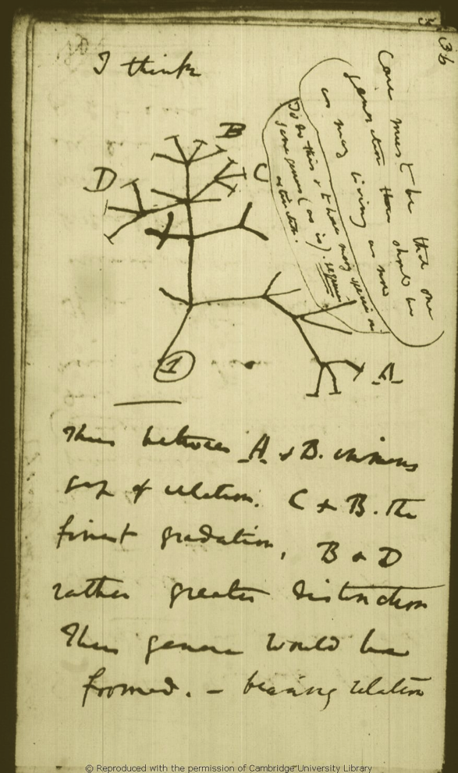
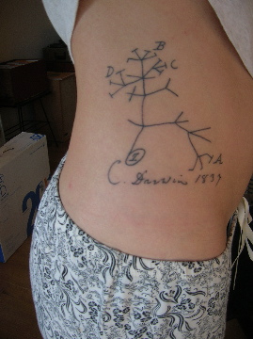
Notebook B: Darwin’s iconic “cogito”
“Case must be that one
generation then should be
as many living as now.
To do this & to have many species in
same genus (as is) requires extinction.”
”Thus between A & B immense
gap of relation. C & B the
finest gradation, B & D
rather greater distinction.
Thus genera would be
formed. — bearing relation”

Slide 6
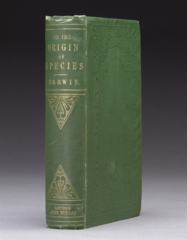
After “thirteen months and ten days hard labour”…
Publication by John Murray in London of On the Origin of Species
November 24th 1859

Slide 7
Family tradition
of religious dissent
and r/evolutionary ideas
Paley’s
Natural Theology
Humboldt’s adventures in
natural history
Scottish enlightenment
Smith’s Invisible Hand
Hutton and Lyell’s
deep time and
uniformitarianism
The Beagle voyage
Fossils and biogeography
Newton’s
law-governed
universe
Malthus
Essay on Population
Darwin’s
Theory of Evolution
Wallace’s letter
Population Thinking
Blurred boundaries
between species and varieties
Mutability of Species
Vestigial features
Natural Selection
Fecundity of Nature
Struggle for Existence
Biogeography
Geography reflects genealogy
Dispersal and Adaptive Radiation
Non-Progressive
Branching Evolution
Variation
Reproduction
Selection
Evolutionary Gradualism
Evolution of complex organs
Nature rich in variety, poor in innovation
Principle of divergence
Taxonomy as Genealogy
Tree of Life: Common Descent
Homology equals similarity
from common ancestry
Sexual Selection
Extinction
Imperfection of fossil record

Slide 8
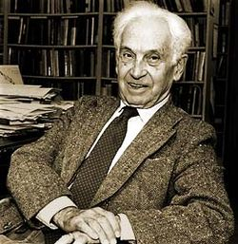
Darwin's Influence on Modern Thought
notion of branching evolution
common descent of all living things from a single origin
the mechanism of evolution is (largely) natural selection
evolution is gradual
no major discontinuities
evolutionary biology, by contrast with physics and chemistry, is a historical science
evolutionary biologists tries to explain events/processes that have already taken place
feeds on variation and randomness
banishing typology and determinism
Ernst Mayr
Jul 5, 1904 – Feb 3, 2005

Slide 9
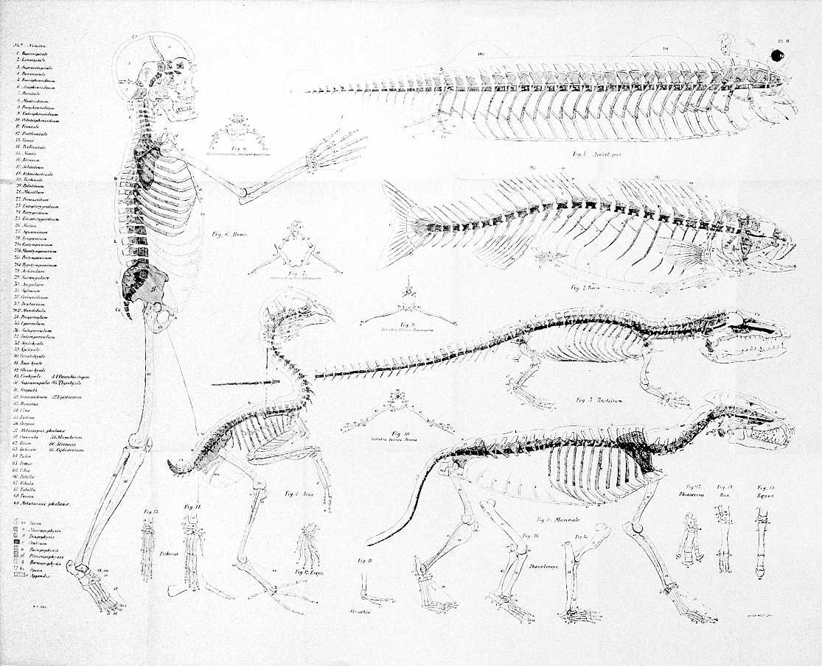
Darwin redefines homology
Biological features in different taxa are homologous if they show similarity based on descent from a common ancestor
Homology thus implies divergent evolution or “descent with modification”

Slide 10
Darwin on Homology
Nothing can be more hopeless than to attempt to explain this similarity of pattern in members of the same class, by utility or by the doctrine of final causes. The hopelessness of the attempt has been expressly admitted by Owen in his most interesting work on the 'Nature of Limbs.' On the ordinary view of the independent creation of each being, we can only say that so it is;—that it has so pleased the Creator to construct each animal and plant.
The explanation is manifest on the theory of the natural selection of successive slight modifications,—each modification being profitable in some way to the modified form, but often affecting by correlation of growth other parts of the organisation. In changes of this nature, there will be little or no tendency to modify the original pattern, or to transpose parts. The bones of a limb might be shortened and widened to any extent, and become gradually enveloped in thick membrane, so as to serve as a fin; or a webbed foot might have all its bones, or certain bones, lengthened to any extent, and the membrane connecting them increased to any extent, so as to serve as a wing: yet in all this great amount of modification there will be no tendency to alter the framework of bones or the relative connexion of the several parts. If we suppose that the ancient progenitor, the archetype as it may be called, of all mammals, had its limbs constructed on the existing general pattern, for whatever purpose they served, we can at once perceive the plain signification of the homologous construction of the limbs throughout the whole class. So with the mouths of insects, we have only to suppose that their common progenitor had an upper lip, mandibles, and two pair of maxillæ, these parts being perhaps very simple in form; and then natural selection will account for the infinite diversity in structure and function of the mouths of insects. Nevertheless, it is conceivable that the general pattern of an organ might become so much obscured as to be finally lost, by the atrophy and ultimately by the complete abortion of certain parts, by the soldering together of other parts, and by the doubling or multiplication of others,—variations which we know to be within the limits of possibility.
http://darwin-online.org.uk/content/frameset?pageseq=452&itemID=F373&viewtype=side

Slide 11
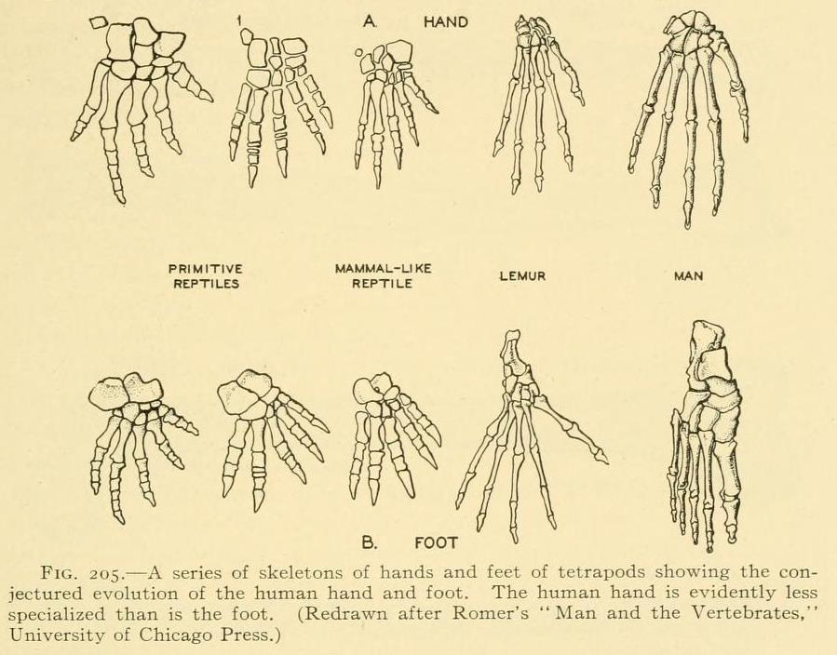
Darwin on Homology
There is another and equally curious branch of the present subject; namely, the comparison not of the same part in different members of a class, but of the different parts or organs in the same individual. Most physiologists believe that the bones of the skull are homologous with—that is correspond in number and in relative connexion with—the elemental parts of a certain number of vertebræ.
On the theory of natural selection, we can satisfactorily answer these questions. In the vertebrata, we see a series of internal vertebræ bearing certain processes and appendages; in the articulata, we see the body divided into a series of segments, bearing external appendages; and in flowering plants, we see a series of successive spiral whorls of leaves. An indefinite repetition of the same part or organ is the common characteristic (as Owen has observed) of all low or little-modified forms; therefore we may readily believe that the unknown progenitor of the vertebrata possessed many vertebræ; the unknown progenitor of the articulata, many segments; and the unknown progenitor of flowering plants, many spiral whorls of leaves. We have formerly seen that parts many times repeated are eminently liable to vary in number and structure; consequently it is quite probable that natural selection, during a long-continued course of modification, should have seized on a certain number of the primordially similar elements, many times repeated, and have adapted them to the most diverse purposes. And as the whole amount of modification will have been effected by slight successive steps, we need not wonder at discovering in such parts or organs, a certain degree of fundamental resemblance, retained by the strong principle of inheritance.
Now called “paralogy”

Slide 12
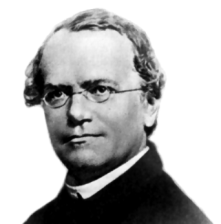
From 1859 to 1959: Genetics
1860s
Mendel’s experiments on peas
1900s onwards
Rediscovery of Mendel (de Vries, Correns, Bateson)
Soma/germ-line distinction (Weismann)
Chromosomes; mutations (Morgan)
1940s
“Modern Synthesis” of Evolution and Genetics (Fisher, Haldane, Wright, Dodzhansky, Mayr)

Slide 13

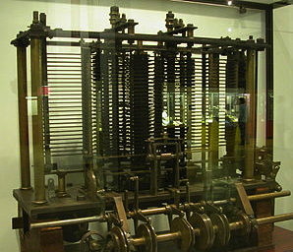
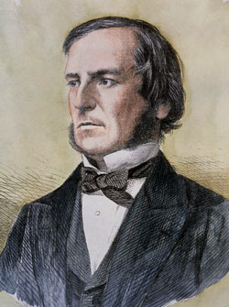
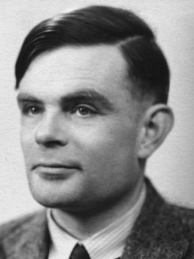
From 1830s to 1959: Computing
1837
Analytical Engine: Babbage
1842
Ada Lovelace: first program
1854
Boolean algebra
1936
Turing machines
1950s
First transisterized computers

Slide 14
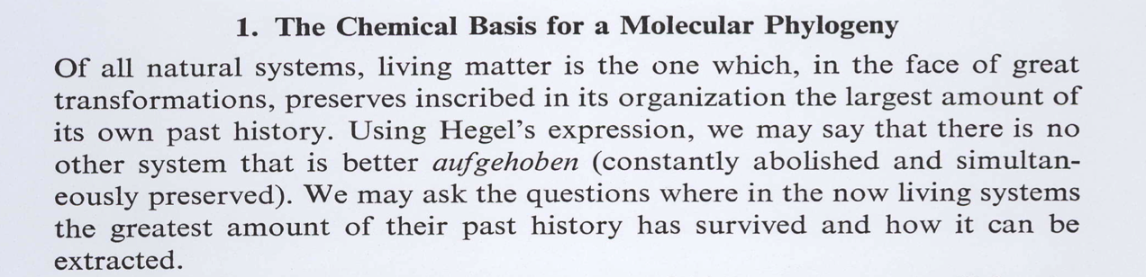
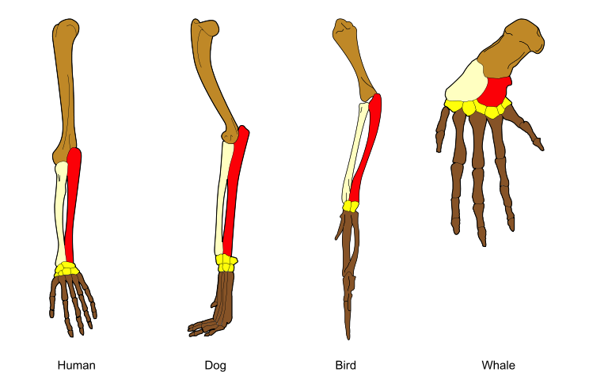
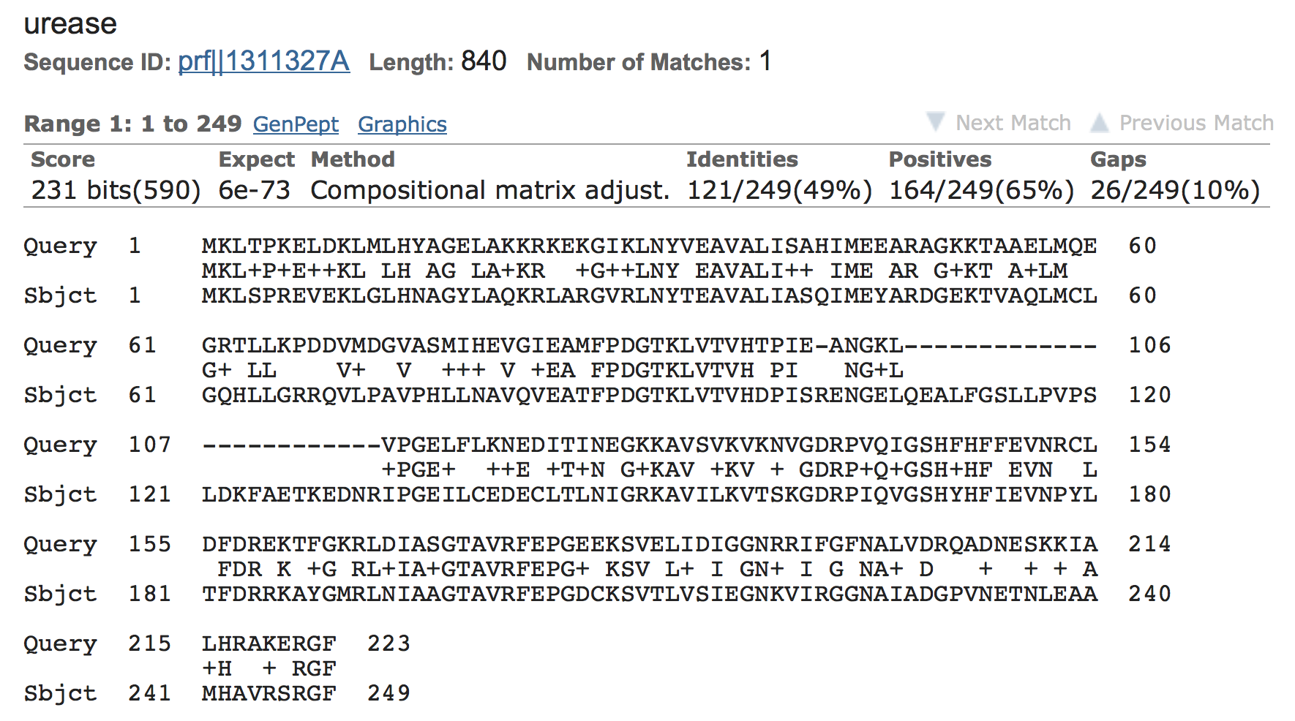
1965: Zuckerkandl and Pauling sequence homology and molecular phylogenetics

Slide 15
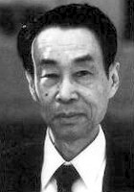
1968: Kimura and the neutral theory
Motoo Kimura
neutral mutations predominate in evolution
downplays role of natural selection in DNA and protein evolution
neutral changes show clock-like behaviour
basis of genomic epidemiology

Slide 16
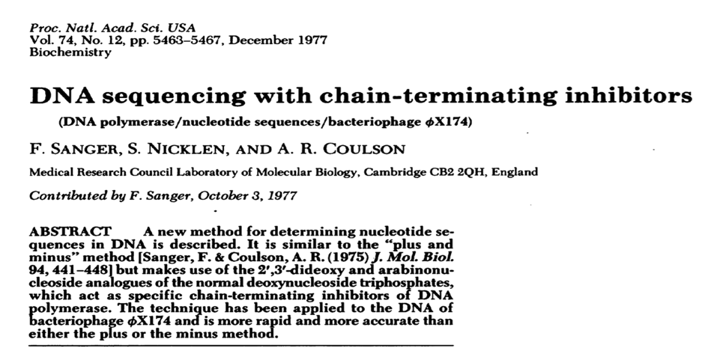
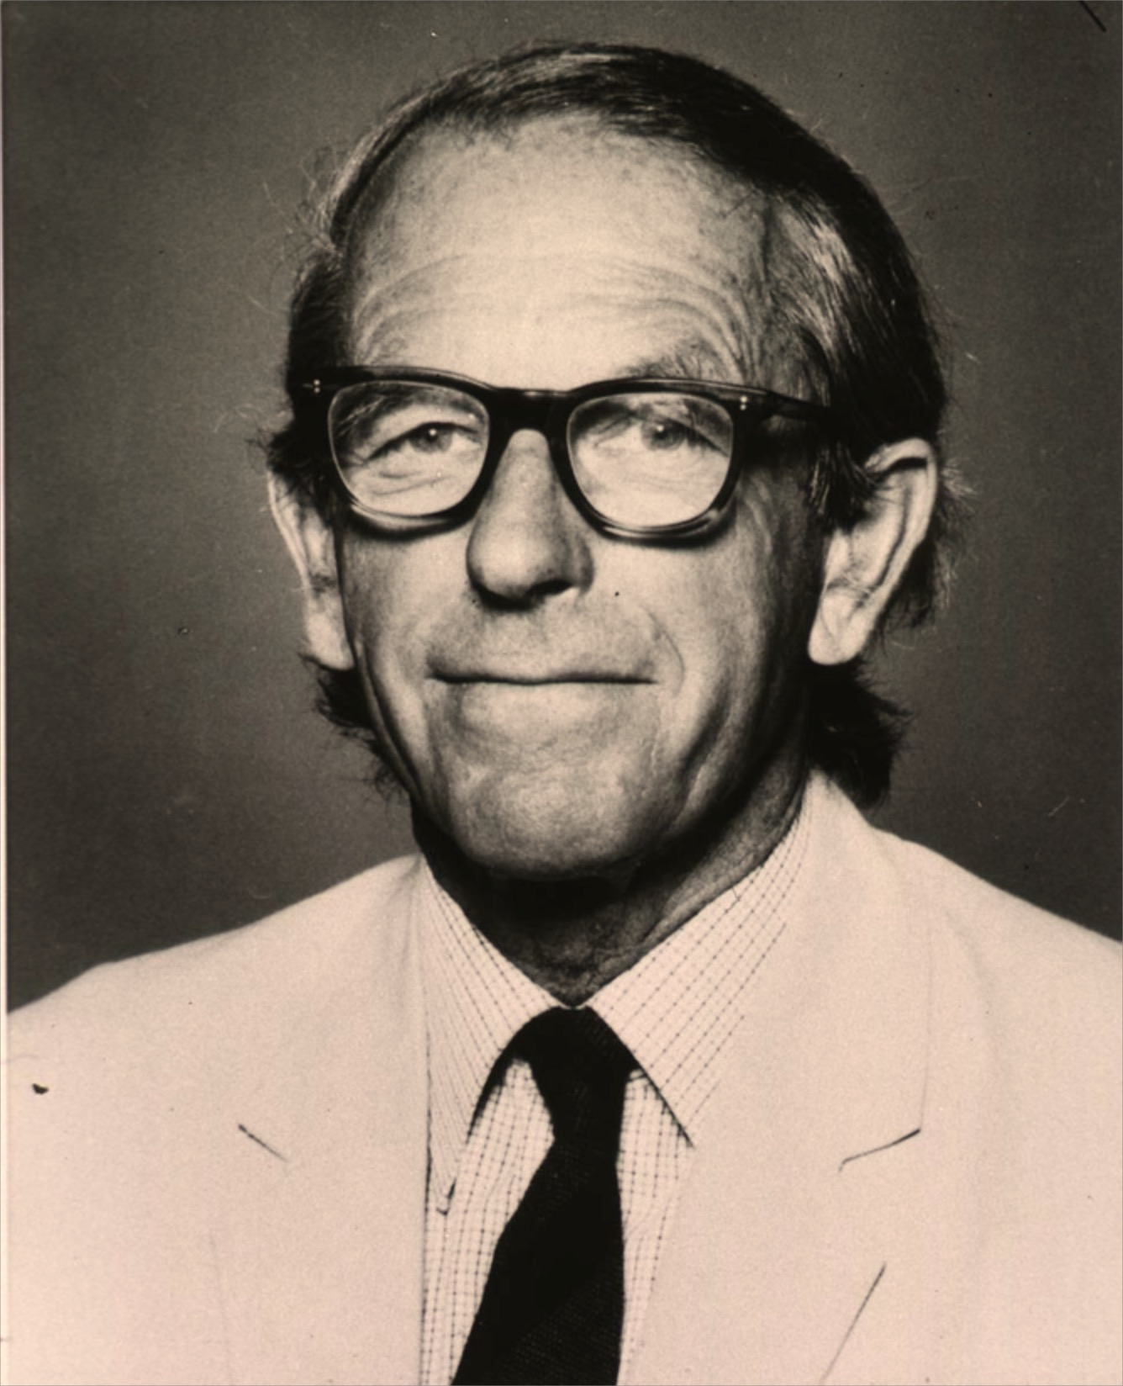
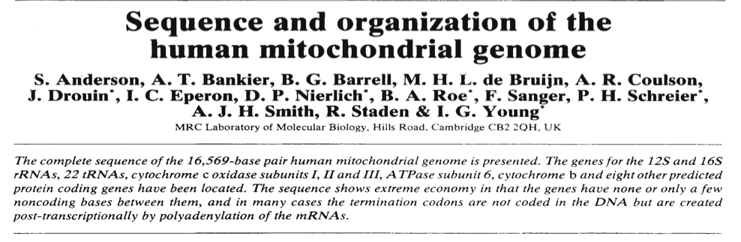
Late 1970s Sanger invents DNA sequencing

Slide 17
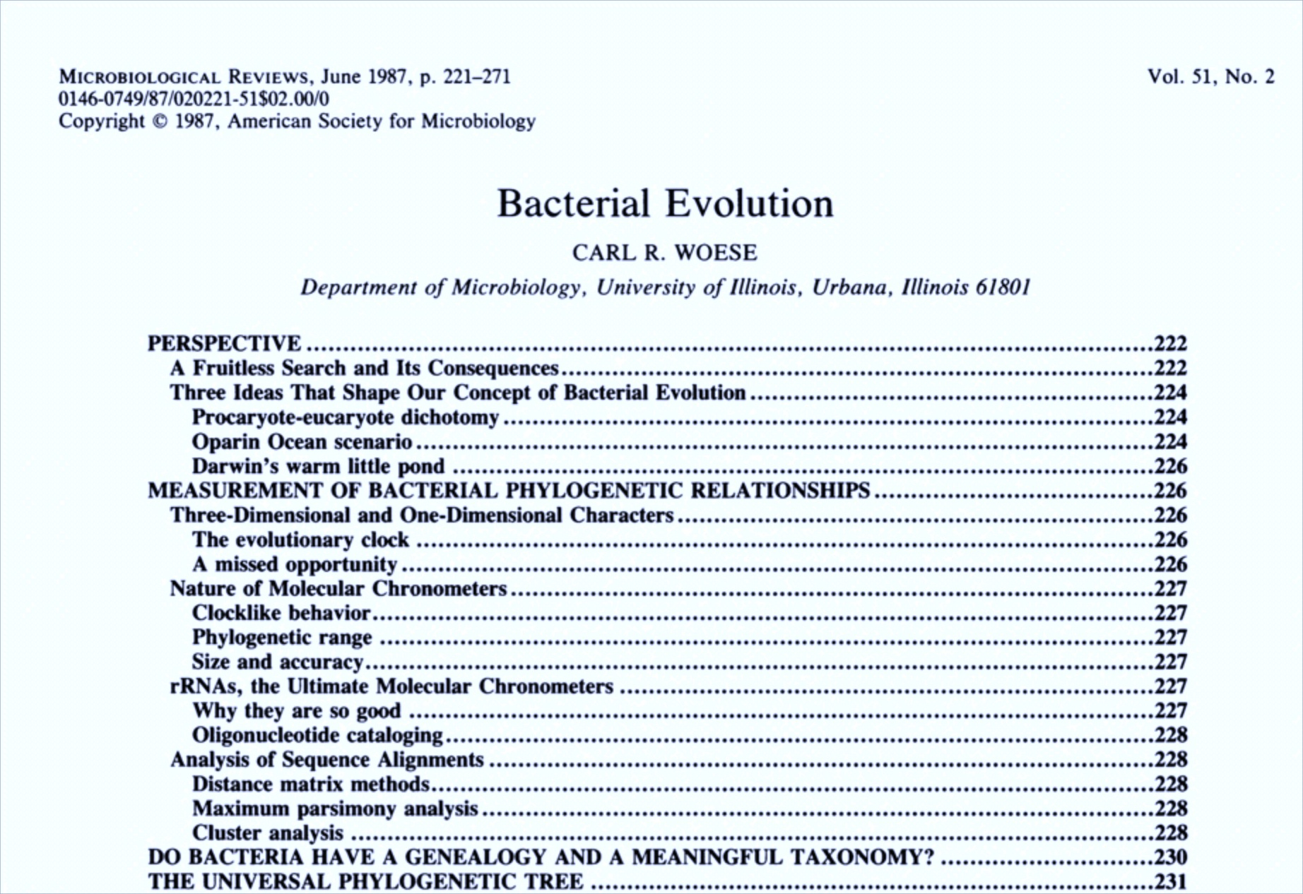
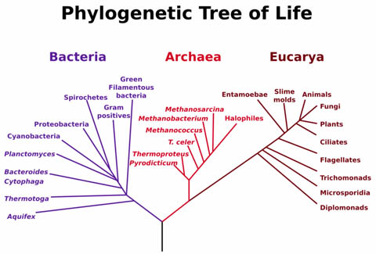
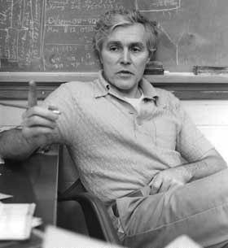
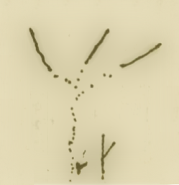
1987: Bacteria join Darwin’s tree of life
Eucarya
Archaea
Bacteria

Slide 18
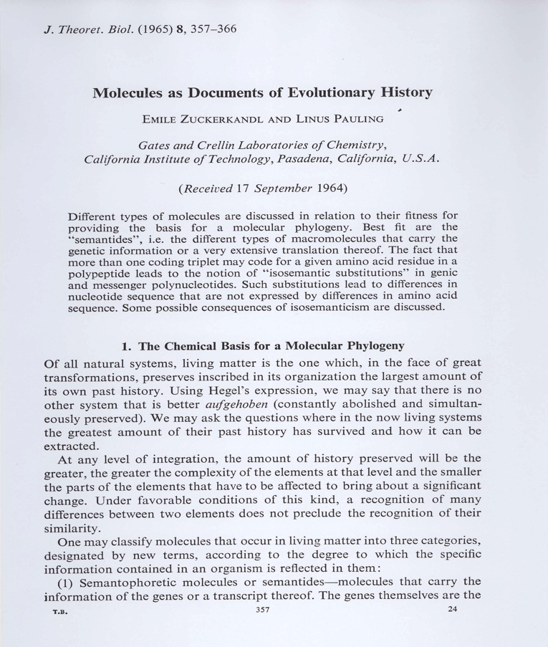
The Great Tree of Life revisited
Trees initially drawn on basis of morphology
Systematised via cladistics in late 20th C
Since 1970s, trees drawn on basis of molecular sequences
General agreement across vast range of taxonomic space
Much more nuanced view
Multiple ways to create a text or a protein
So close similarity in arbitrary features suggests plagiarism or common descent

Slide 19
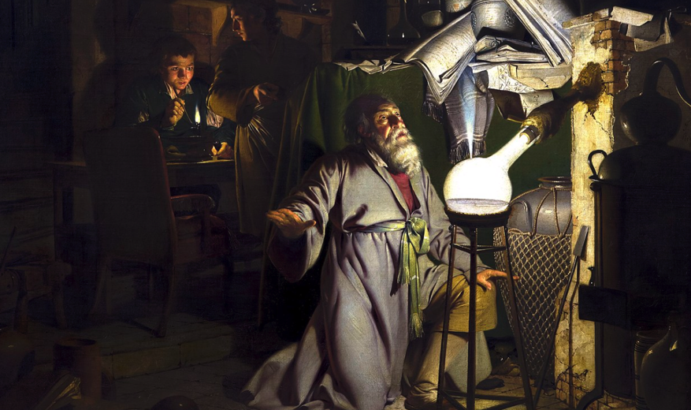
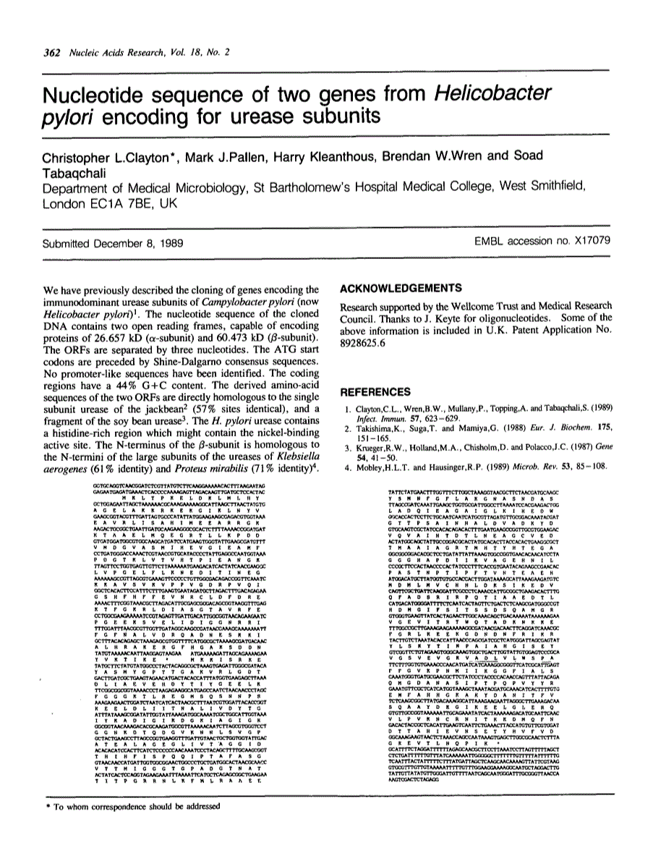
15 September 1989
Then felt I like some watcher of the skies
When a new planet swims into his ken;
Or like stout Cortez when with eagle eyes
He star'd at the Pacific—and all his men
Look'd at each other with a wild surmise—
Silent, upon a peak in Darien.

Slide 20
Sequence homology
Languages and informational macromolecules consist of sequences of characters that show “descent with modification”
Similarity due to descent from common ancestor (homology) can be used to infer function or meaning
one, two, three
eins, zwei, drei
un, deux, troi
uno, dos, tres
Hittite (20-13th C BCE)
nu NINDA-n ezzateni watar-ma ekutteni
nu BREAD-n ezzateni watar-ma ekutteni
Now you will eat BREAD,
And you will drink water
Hrozný, Bedřich (1917)
Notes:
12

Slide 21
Sequence alignment and homology
Easy if have exact match
...but sequences diverge over time
Need alignment and search methods that allow for variability
Gap penalties
Substitution scores
ATCGATCGGGCT
||||||||||||
ATCGATCGGGCT
TDAAINPGNSG
|||||||||||
TDAAINPGNSG
ATCGATCGGGCT
||| ||||||||
ATCCATCGGGCT
TDAAINPGNSG
|||:|||||||
TDASINPGNSG
ATCG-ATCGGGCT
||| |||||||
ATCCAATCGGGCT
TDA-------AINPGNSG
||| |:||
TGGvspyadpNTCRGDSG
TTTTTTT------
-------GGGGGG

Slide 22
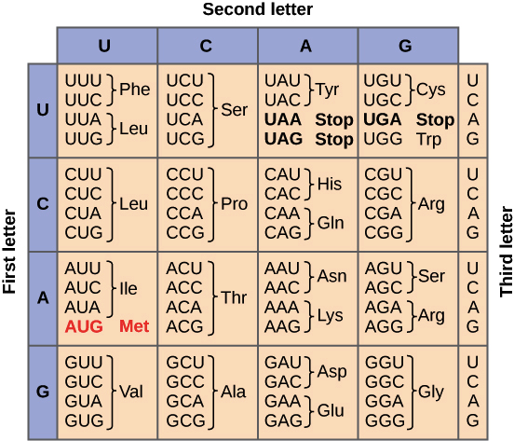
Sequence alignment and homology
Amino acid sequences more highly conserved than nucleotide
SER LEU GLY PRO
TCT CTA GGG CCC
|| || || ||
TCG CTT GGC CCG
4/4 Identical amino acids
8/12 nt matches
SER LEU GLY PRO
TCT CTA GGG CCC
| || ||
AGT TTG GGC CCG
4/4 Identical amino acids
5/12 nt matches

Slide 23
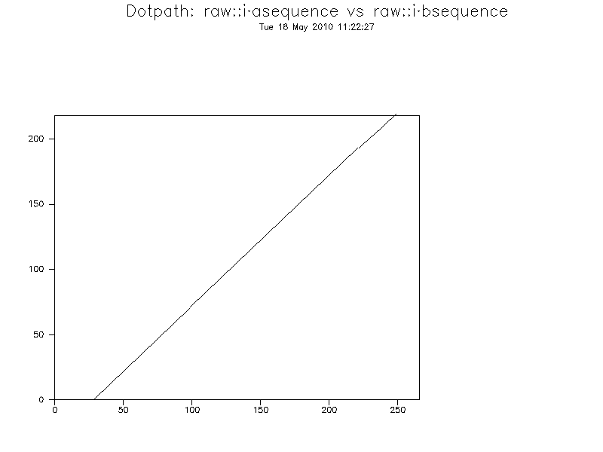
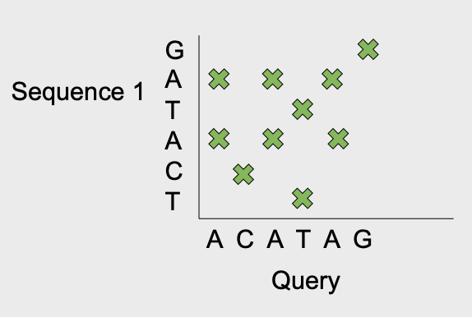
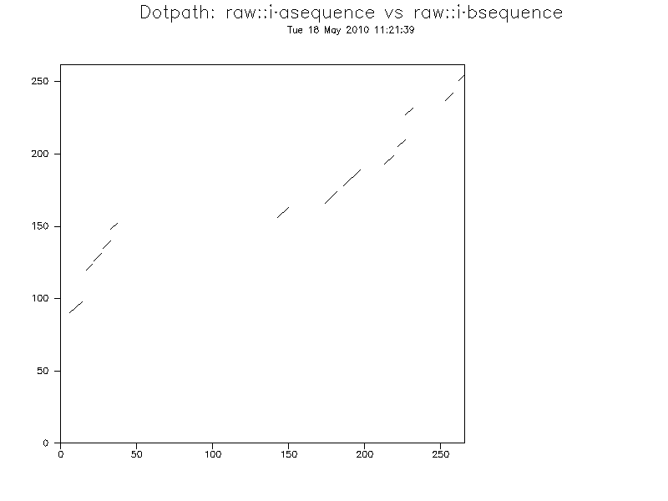
Dot plot

Slide 24
Turning dot plot into an algorithm
Simple algorithm – penalise movement away from diagonal – gap penalty
-10
0
-10
0
-10
-10

Slide 25
Gap extend penalty?
Single block of insertions/deletions is more likely than multiple in/del events
NV-ELKAET
|| | |
NVDE--A-TNFELKAET
NV------ELKAET
|| ||||||
NVDEATNFELKAET

Slide 26
Gap extend
To encourage this we apply a low penalty per each gap, and a high one just to open a gap.
Gap open = 10
Gap extend = 0.5
-11
-10.5
-0.5
-10.5
-10.5
0
0
-10.5
-10.5
-10
-0.5
0
-10.5
-11
-10
-0.5
-0.5

Slide 27
Match/mismatch
We need to tell the algorithm that matching letters are better than mismatches too
This is done via a scoring matrix
A C G T
A
C
G
T
5 -4 -4 -4
-4 5 -4 -4
-4 -4 5 -4
-4 -4 -4 5

Slide 28
Putting the two together gives us a scoring mechanism
A
-14
-13.5
6
C
-18.5
1
-13.5
T
-4
-18.5
-23
A
C
A

Slide 29
Needleman-Wunsch
To pick the optimal alignment, start at the end and trace back the highest scoring route.
A
-14
-13.5
6
C
-18.5
1
-13.5
T
-4
-18.5
-23
A
C
A
Notes:
Where there are 2 paths, pick best scoring

Slide 30
Global versus Local Alignments
Smith-Waterman algorithm best for local alignments
Sets negative scores in matrix to 0, allows trace back to end and restart
Global
Local
Notes:
Where there are 2 paths, pick best scoring

Slide 31
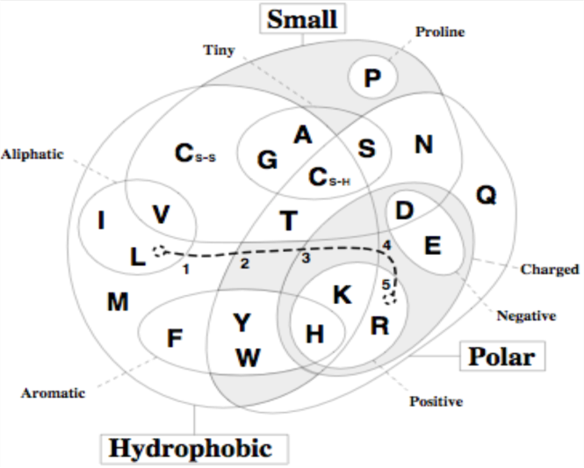
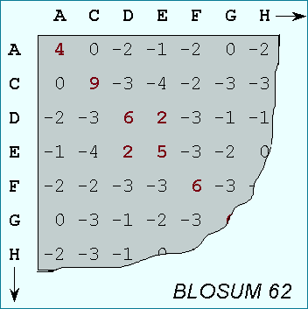
Protein substitution matrices
Can look at closely related proteins to determine substitution rates
Two most commonly used models:
BLOSUM
PAM

Slide 32
Homology vs. Similarity
Presence of similar features because of common decent
Cannot be observed since the ancestors are not anymore
Is inferred as a conclusion based on ‘similarity’
Some authorities claim homology is like pregnancy: either one is or one isn’t! (Gribskov – 1999)
Quantifies a ‘likeness’
Uses statistics to determine ‘significance’ of a similarity
Statistically significant similar sequences are considered ‘homologous’

Slide 33
Homology Searches
The aim of homology searches is to identify sequences within these databases that are homologous to your sequence.
This involves comparing your sequence with all the database sequences, looking for stretches of sequence that appear to be similar, then scoring the matches and ranking them. Usually a measure of the significance of the match will be given
BLASTN
Nucleotide query versus nucleotide database
BLASTP
protein query versus protein database
BLASTX
automatic 6-frame translation of nucleotide query versus protein database
TBLASTN
protein query versus automatic 6-frame translation of nucleotide database
TBLASTX
automatic 6-frame translation of nucleotide query versus automatic 6-frame translation of nucleotide database

Slide 34
BLAST – Basic Local Alignment Search Tool
creates word list of exact sequence & high scoring substitutions
scans database sequences for exact matches to these words
if two hits found on same diagonal alignment, extended until score drops off
High-scoring Segment Pairs (HSPs)
approach rules out many database sequences early on
large increase in speed
Altschul et al (1997) generation of protein database search programs", Nucleic Acids Res. 25:3389-3402.

Slide 35
Evidence for homology
similarity extends over a long stretch of sequence and is statistically significant by criteria known to be reliable (e.g. BLAST e values)
if sequence similarity is low, same pattern of identical or similar amino acid residues seen in multiple sequences
pattern of sequence similarity reflects the similarity between experimentally determined structures of the respective proteins or at least corresponds to the known key elements of one such structure
conserved stretches suggest important functions

Slide 36
Evidence for homology
not just interested in score for an alignment...
...but how likely we are to get that alignment by chance alone
it is this ‘non-random’ alignment that implies homology
Statistics are used to estimate this chance
The expect value or E-value
Probability of obtaining this score by chance
Best measure of how biologically significant an alignment is
Used for ranking results by default
Karlin-Altschul statistics
Statistical theory based on the extreme value distribution of the best scores for pairs of sequences; used for E-value calculation in BLAST

Slide 37
E values
The “Expect Value” is the number of times that an alignment as good or better than that found by BLAST would be expected to occur by chance, given the size of the database searched
Low e value is evidence for homology
BLAST default of “10” is designed to ensure no biologically significant alignment missed.
But clearest homology seen when e value contains an e!
2e-19
1e-66

Slide 38
Rules of thumb for homology searches
Whenever possible, compare at the amino acid level rather than at the nucleotide level (BLASTP)‏
Then with translated DNA query sequences (BLASTX)
Search with DNA vs. DNA as the next resort (BLASTN)
And then against translated DNA database sequences (TBLASTX) as the VERY LAST RESORT!

Slide 39
Rules of thumb for homology searches
Beware of simple sequences
many proteins contain low (compositional) complexity regions where distribution of amino acids is non-random, i.e. deviates from the standard statistical model
biased amino acid composition, e.g. rich in glycine or proline, or in acidic or basic amino acid residues; homopolymers
low-complexity sequences with amino acid periodicity, e.g. in coiled-coil and other non-globular proteins (e.g. collagen or keratin)
these sequences show similarity not indicative of homology
problem addressed by using composition-based statistics
many not genuinely translated coding sequences, particularly if short

Slide 40
>EHZ2931719.1 cell division protein FtsN [Salmonella enterica]
MAQRDYVRRGQPAPSRRKKSTSRNSRKKQSNMPAVSPAMVAIAAAVLVTFIGGLYFITHHKKEESETLQN
QKVTGNGLPPKPEERWRYIKELESRQPGVRTPTEPSAGGEVMNPNQLTSEQRQLLEQMQADMRQQPTQLN
EVPWNEQTPEQRQQTLQRQRQAQQQQQQQQQQQQQQQQQQQQWAQTQPVQQPRTQPRVNEQPQTRTVQSA
PAQPARQSQPPKQTASQQPYQDLLQTPAHTSAAAPKAAPITRAPEAPKPTAEKKDERRWMVQCGSFKGAE
QAESVRAQLAFEGFDSKITTNNGWNRVVIGPVKGKENADSTINRLKMAGHTNCIRLATGG
>WP_062859611.1 VWA domain-containing protein [Vibrio parahaemolyticus]
MAEFTFLNPYWLLGLITIPFVLLINQKFRAKKSALIAPHLAKMLGKTIQSKPYFTIWGLAWAIACVALAG
PSWQSNTRPSFELSQNRMLVLDMSRSMYASDIKPNRLTQTRYKALDLLPKWKEGATGLIAYAGDAYSLSP
LTTDASTLAGIIENLSPELMPFQGSNLPAAIELALSQFSQAGANQGDIVVLADDLDDSELARSLNLVKGK
NIRVSVLAIGTANGAPIALPDGSLLKTTQGSTVVAKTHLKNLQTLANKTGGMFVPIQHNNRDVDSIAAYT
NNTGNNLAAKQNQEVKTDSRLNGGFWLLPLLLLPTVFLFRRGVIWVFFAALLPMTWTPGAQANPFLNADQ
QAANLYKQGEYEQAKNLFTDPSWQGAASYQTGDYEAAIKAFSNDPSQTGRYNLANALAQNGQLEEADKQY
KKLLKENPDFEAAKKNLSVVEEKLKQQQQQQQQQQQQQQQQQQQQQQQQQQQQQQQQQQQQQQQKSQNST
KQEQGQQSQNQQDAENKKEKQESEHKAKQQKAETEVEKQGEQKKGEPMQAQVQPEKSHQDDPEFRRLEAV
ERARDPSFLIRAQMQLQAQQKQRPQQSQKEW
>MBB5201672.1 hypothetical protein HNR39_003530, partial [Glaciimonas immobilis]
QQQQQQQQQQQQQQQQQQQQQQQQQQQQQQQRPQPR

Slide 41
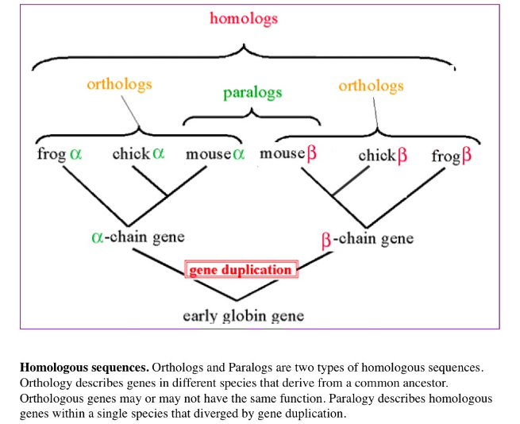
Orthology versus Paralogy
Homology can be reliably inferred from statistically significant similarity
But remember:
Orthologous sequences generally have similar functions
Paralogous sequences can acquire very different functional roles
So further work might be needed to tease out details

Slide 42
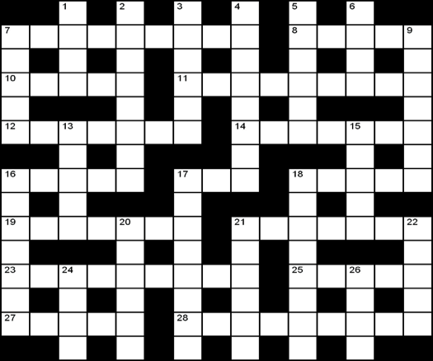
Annotation and its problems
Signal Peptide
A
Proteins consist of domains
Signal Peptide
B
Transitivity of Homology
Coiled coil domain
C
Toxin Domain
Distant Homology
D
The annotation catastrophe: all these proteins get labelled “toxin”, because they show homology to a protein containing a toxin domain, but the homology is actually in an entirely different domain!
Number of proteins annotated by homology >>> those with with experimentally verified functions
Need to chase evidence trail back to experimental or structural evidence
Notes:
14

Slide 43
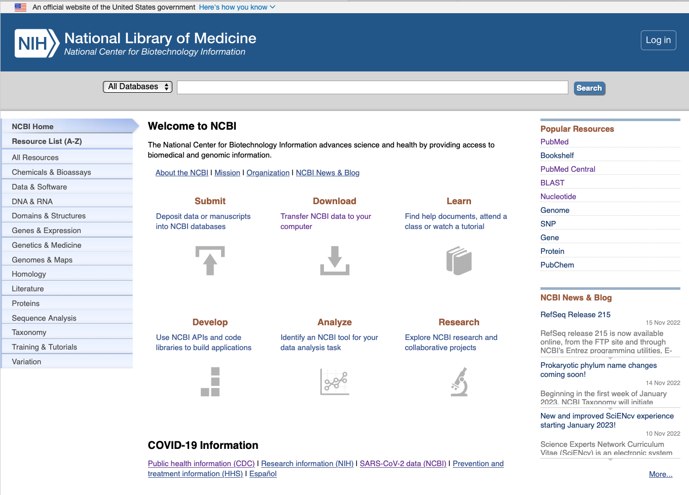
The awesome power of NCBI!
https://www.ncbi.nlm.nih.gov

Slide 44
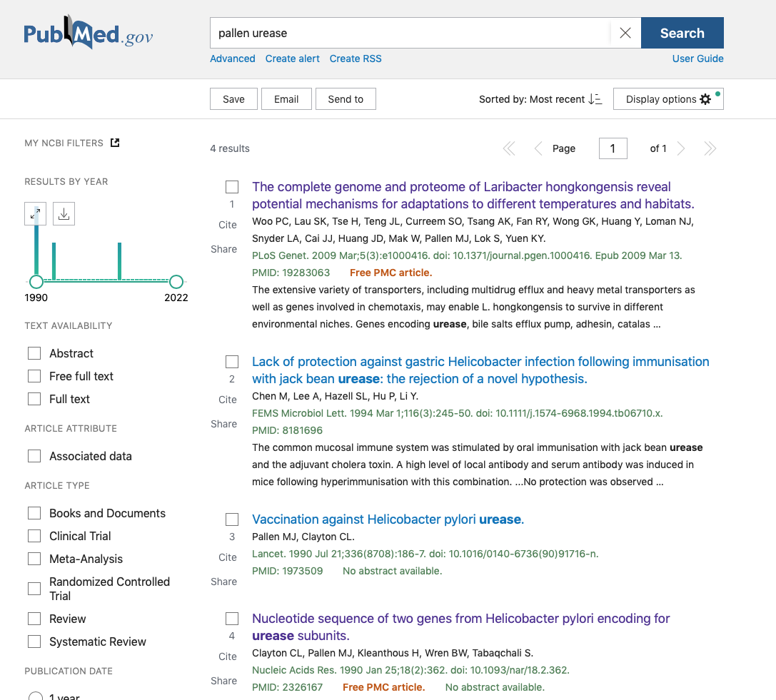

Slide 45



Slide 46



Slide 47



Slide 48


Slide 51

Domain searches

Slide 52


Slide 53




Slide 54


https://www.ncbi.nlm.nih.gov/books/NBK279690/

Slide 55



Back to Darwin
http://darwin-online.org.uk/Variorum/

Slide 56


Slide 57




Back to 1859: Darwin’s grandeur
There is grandeur in this view of life, with its several powers having been originally breathed into a few forms or into one; and that whilst this planet has been cycling on according to the fixed law of gravity, from so simple a beginning endless forms most beautiful and most wonderful have been, and are being, evolved.

Slide 58
Further reading and acknowledgments
https://www.ncbi.nlm.nih.gov/books/NBK20260/
https://www.ncbi.nlm.nih.gov/books/NBK1734/
https://www.ncbi.nlm.nih.gov/home/tutorials/
https://www.ncbi.nlm.nih.gov/Class/BLAST/blast_course.short.html
Sequence searching and alignments - Andrew Cowley EBI
www.ebi.ac.uk/sites/ebi.ac.uk/files/content.ebi.ac.uk/materials/2012/120508_Rotterdam/sequence_searching_alignments_cowley.2012.pptx

